Slide 1
Remaining parts of Composite Pattern and then Adapter Pattern

Slide 2
Composite Implementation: Alternatives
Component does not know what it is a part of:
  Component can be in many composites
  Component can be accessed only through composite
Component knows what it is a part of
  Component can be in only one composite
  Component can be accessed directly

Slide 3
Composite: Issues with Part-of
Rules when component knows its single composite:
  A is a part of B if and only if B is the composite of A
  However, duplicating information is dangerous!
Problem: How to ensure that references of components to composite and composite to components are consistent?
B1
B2
A
A

Slide 4
Ensuring consistency
The public operations on components and composites are:
  Composite can enumerate components
  Component can name its container
  Add/remove a component to/from the composite
    The operation to add a component to a composite updates the container of the component

Slide 5
addChild() in Composite
public void addChild(Component child) {
ensureCapacity();
childArray.add(child);
child.setParent(this);
}

Slide 6
Exercise 4: Composing GUI
Q: How can we add any widget to another, for example panels to an applet?

Slide 7
Solution: Composing GUI
public class MyApplet extends java.applet.Applet {
public MyApplet() {
add(new Label(“My label”));
add(new Button(“My button”));
Panel myPanel = new Panel();
myPanel.add(new Label(“Sublabel”));
myPanel.add(new Button(“Subbutton”));
add(myPanel);
}
}

Slide 8
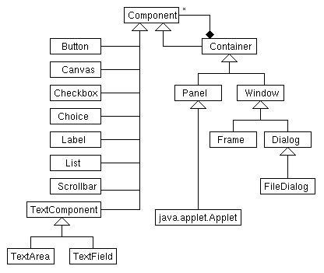
AWT Components

Slide 9
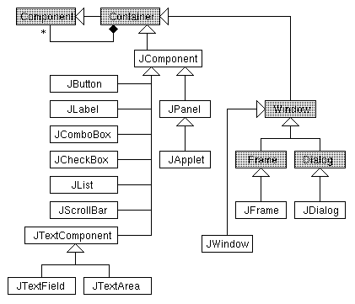
Swing Components
Every widget is a container!
Every Container is a Component!

Slide 10
Composite: Consequences
Benefits:
  Makes it easy to add new kinds of components
  Makes clients simpler, since they do not have to know if they are dealing with a leaf or a composite component
Liabilities:
  Makes it harder to restrict the type of components of a composite

Slide 11
Adapter Pattern

Slide 12
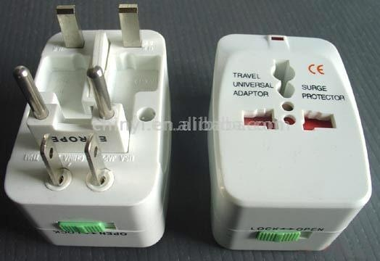


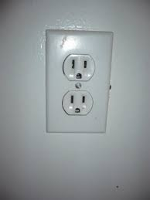

Adapter Pattern --a Wrapper Pattern
Intent
  Convert the interface of a class to the interface expected by the users of the class.
  Allows classes to work together even when they have incompatible interfaces.
Example (non-software)
  You went to U.S.
  Had an Indian electrical appliance?
  How can you use it in U.S.?
  Use Adapters!
Also universal adapters?

Slide 13
Adapter Pattern
Wrapper
It is a wrapper pattern
“Convert the interface of a class into one that a client expects.”
  Lets two classes work together --- that couldn’t otherwise --- because of incompatible interfaces
  Used to provide a new interface to existing legacy components.
Two main adapter variants:
  Class adapter:
    Uses interface implementation and inheritance
  Object adapter:
    Uses delegation to adapt one interface to another
Object adapters are much more common.
Client
Server

Slide 14
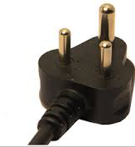
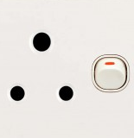



Essential Idea Behind Adapter Pattern
Target
Adaptee
Old interface
Old package
New package
Client
Old interface
New interface
Client
Adapter
New package

Slide 15
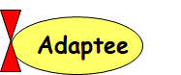
Adapter Pattern: Basics
Adapter
  Helps two incompatible types to communicate.
    A class expects an interface ---but that is not supported by a server class,
    The adapter acts as a translator between the two types.
3 essential classes involved:
    Target – Interface that client uses.
    Adapter - class that wraps the operations of the Adaptee in interface familiar to client.
    Adaptee - class with operations that the client class desires to use.
Target
Adaptee
Target
Adapter
Adaptee

Slide 16

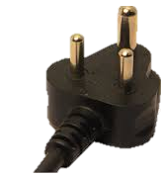
Target
Adapter
Adaptee

Slide 17
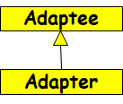

Class and Object Adapters
An adaptee may be given a new interface by an adapter in two ways:
Inheritance
  The adapter sub-classes the adaptee;
  This is the Class Adapter pattern
Delegation
  The adapter holds a reference to the adaptee and delegates work to it;
  This is the Object Adapter pattern

Slide 18
Example 1 – Sets
There are many ways to implement a set
Assume:
  Your existing set implementation has poor performance.
You got hold of a more efficient set class,
  BUT: The new set has a different interface.
  Do not want to change voluminous client code
Solution: Design a class setAdapter:
  Same interface as the existing set..
  Simply translates to the new set’s interface.
Application
Set
NewSet
Adapter
Notes:
Of the many ways to implement a set, we have the one we’re using (OldSet) and the one we’ve acquired (NewSet). They have equivalent
functionality, but incompatible interfaces.

Slide 19
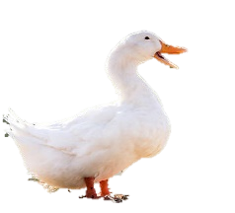
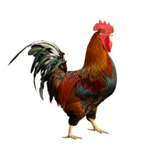
Class Adapter: Main Idea
Target
quack();
Adaptee
Cock-a-Doodle();
Client
Adapter
quack();

Slide 20
Object Adapter: Main Idea
Target
quack();
Adaptee
Cock-a-Doodle();
Client
Adapter
quack();

Slide 21
Example: Solution
Client
OldSet
Existing
add(Object e)
del(Object e)
int cardinality()
contains(Object e)
Got hold of Newset…
Target
NewSet
?
insert(Object e)
remove(Object e)
int size()
contains(Object e)
But, do not want to change Client code…
Adaptee
Notes:
This shows the current system, where clients use the interface given by OldSet, and we want to substitute in objects of type NewSet.

